Slide 1


SERVICE WORKSHOP
AUGUST 2026 - IRVING TEXAS

Slide 2
2025 Shottenkirk Automotive Group Night of Honors

Slide 3


INTRODUCTIONS
SERVICE WORKSHOP
All Rights Reserved – Shottenkirk Automotive Group - 2026
Notes:
9:45-10:20

Slide 4

SERVICE WORKSHOP
AUGUST 2026 - IRVING TEXAS

Slide 5
Agenda:
• SPI- Service Pricing for Inspect Discussion/Presentation
• Executive snapshot
• Media metrics and revenue opportunity
• Closing rate and quote-send behaviors
• Invite capture, declines, and pending ASRs
• Store-level focus areas
• 30-day action plan
Cox Automotive
1
Notes:
[Sources]
Data source: Shotenkirk Media Report YTD 6-30-2026.xlsx
Data source: Shottenkirk Invite Stats .xlsx
Design reference: Shottenkirk_Fixed_Operations_Workshop 11-3-2025.pptx

Slide 6
Executive Snapshot
2026 YTD: media usage and Invite performance show clear revenue and process opportunities.
141,211
64,895
$7.11M
+$110
+5.8 pts
Customer-pay & warranty ROs in media report
ROs without media attached
Media opportunity from no-media ROs
Average $/RO lift with media
Avg close-rate lift
$10.80M
$1.83M
$358,486
15.7%
+4.3%
YTD Invite revenue
June Invite revenue
Last-month decline revenue
Pending ASR avg
Improved Pending ASR %
• Use media as the proof point: average $/RO and closing rates are both higher when media is included.
• Target store coaching where opportunity is large, media adoption is low, or quote-send activity is below average.
• Invite momentum is positive: June capture is above the YTD average, and pending ASR follow-up is improving but remains a measurable focus area.
Notes:
[Sources]
Data source: Shotenkirk Media Report YTD 6-30-2026.xlsx
Data source: Shottenkirk Invite Stats .xlsx
Design reference: Shottenkirk_Fixed_Operations_Workshop 11-3-2025.pptx
Slide 3 update requested: removed 79.9% email capture box, moved 15.7% Pending ASR average into that position, and added +4.3% Improved Pending ASR %.

Slide 7
Media Metrics and Why It Matters
Proof, transparency, and customer confidence in the service lane
Cox Automotive
3
Notes:
[Sources]
Data source: Shotenkirk Media Report YTD 6-30-2026.xlsx
Data source: Shottenkirk Invite Stats .xlsx
Design reference: Shottenkirk_Fixed_Operations_Workshop 11-3-2025.pptx

Slide 8
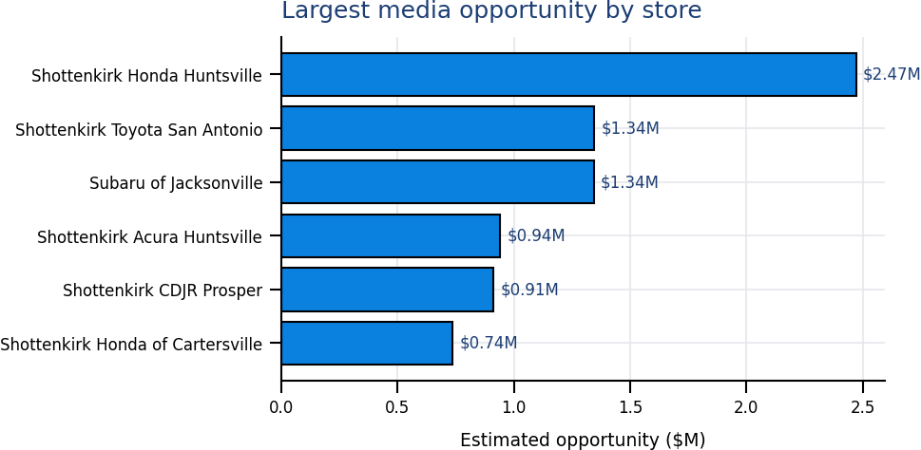
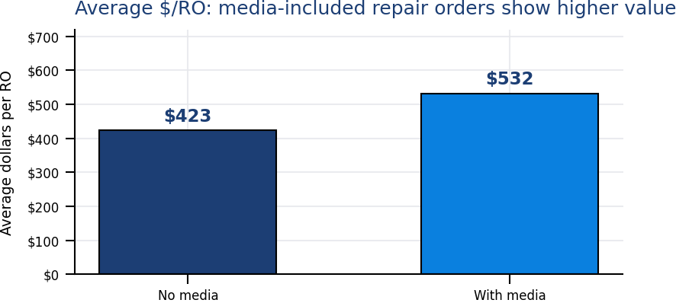
+
Media Drives Higher RO Value
•
Average $/RO is higher when media is used, with a $7.11M opportunity tied to no-media ROs.
Store
Opp.
Media
Quote
Honda Huntsville
$2.47M
22%
68%
• Prioritize coaching on stores where the dollar opportunity is meaningful and the process metric still leaves room to grow.
• Pair media expectations with advisor language that explains why media reduces uncertainty and supports approval decisions.
Toyota San Antonio
$1.34M
83%
74%
Subaru Jacksonville
$1.34M
71%
58%
Acura Huntsville
$0.94M
24%
27%
CDJR Prosper
$0.91M
58%
77%
Cox Automotive
4
Notes:
[Sources]
Data source: Shotenkirk Media Report YTD 6-30-2026.xlsx
Design reference: Shottenkirk_Fixed_Operations_Workshop 11-3-2025.pptx

Slide 9
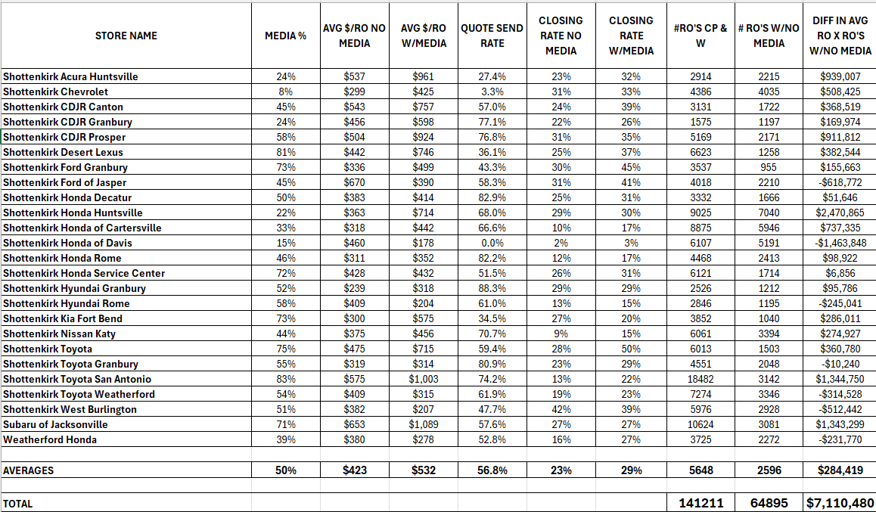

Slide 10
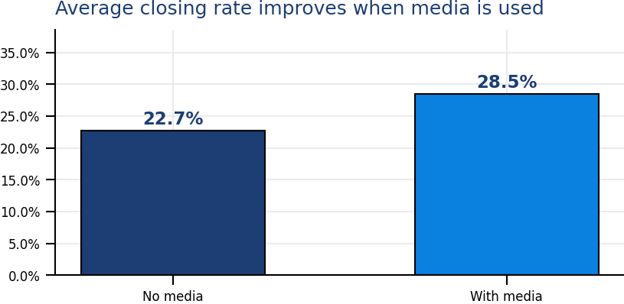
+
Media Improves Closing Rate
•
The group average closing rate rises from 22.7% without media to 28.5% with media.
Store
Lift
No media
With media
Media
Toyota
22.0 pts
28%
50%
75%
Ford Granbury
15.0 pts
30%
45%
73%
CDJR Canton
15.0 pts
24%
39%
45%
Desert Lexus
12.0 pts
25%
37%
81%
Weatherford Honda
11.0 pts
16%
27%
39%
• Manager takeaway: media is not just documentation. It is a sales-enablement tool that supports transparency, faster customer decisions, and stronger approval behavior.
• Coach to the full path: inspect, capture media, send quote, explain value, follow up on declines.
Cox Automotive
6
Notes:
[Sources]
Data source: Shotenkirk Media Report YTD 6-30-2026.xlsx
Design reference: Shottenkirk_Fixed_Operations_Workshop 11-3-2025.pptx

Slide 11
+
Quote-Send Behavior: Store Focus Areas
•
Media impact compounds when quote-send activity is consistent and timely.
Lowest quote-send stores
Quote rate
Media
Opp.
Low media / high opp.
Media
Quote
Opp.
Honda Davis
0.0%
15%
$-1.46M
Honda Huntsville
22%
68%
$2.47M
Chevrolet
3.3%
8%
$0.51M
Acura Huntsville
24%
27%
$0.94M
Acura Huntsville
27.4%
24%
$0.94M
Honda Cartersville
33%
67%
$0.74M
Kia Fort Bend
34.5%
73%
$0.29M
Chevrolet
8%
3%
$0.51M
Desert Lexus
36.1%
81%
$0.38M
CDJR Canton
45%
57%
$0.37M
Recommended coaching language
Process check
“Every recommended service should tell a visual story the customer can understand before they approve or decline.”
Confirm media is captured before quote send, then review no-media exceptions by advisor and technician.
Cox Automotive
7
Notes:
[Sources]
Data source: Shotenkirk Media Report YTD 6-30-2026.xlsx
Design reference: Shottenkirk_Fixed_Operations_Workshop 11-3-2025.pptx

Slide 12
Customer Engagement and Invite Performance
Capture, declines, and pending ASR follow-up
Cox Automotive
8
Notes:
[Sources]
Data source: Shotenkirk Media Report YTD 6-30-2026.xlsx
Data source: Shottenkirk Invite Stats .xlsx
Design reference: Shottenkirk_Fixed_Operations_Workshop 11-3-2025.pptx

Slide 13
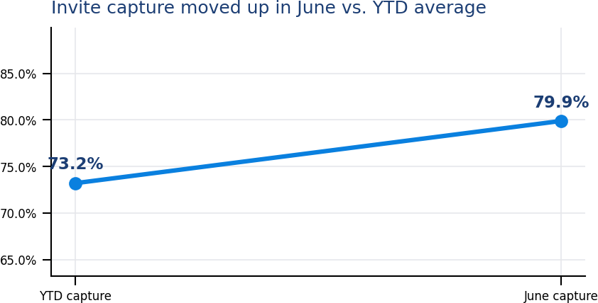
+
Invite Performance Update
•
June capture outpaced the YTD average, supported by $10.80M in YTD Invite revenue.
$10.80M
$1.83M
Total Invite revenue YTD
Invite revenue last month
10.6%
16.2%
Average YTD no-email rate
Average YTD opt-out rate
Top capture improvement
Change
YTD
June
Weatherford Honda
34.0 pts
73%
88%
• Protect the gains: review the improved stores and identify what changed in advisor process, customer contacts, or daily management cadence.
• Use no-email and opt-out rates to coach contact capture at write-up, not after the RO is already closed.
Ford of Jasper
28.0 pts
88%
95%
Hyundai Rome
22.0 pts
63%
71%
Honda Rome
22.0 pts
71%
67%
Kia Fort Bend
22.0 pts
84%
93%
Cox Automotive
9
Notes:
[Sources]
Data source: Shottenkirk Invite Stats .xlsx
Design reference: Shottenkirk_Fixed_Operations_Workshop 11-3-2025.pptx

Slide 14
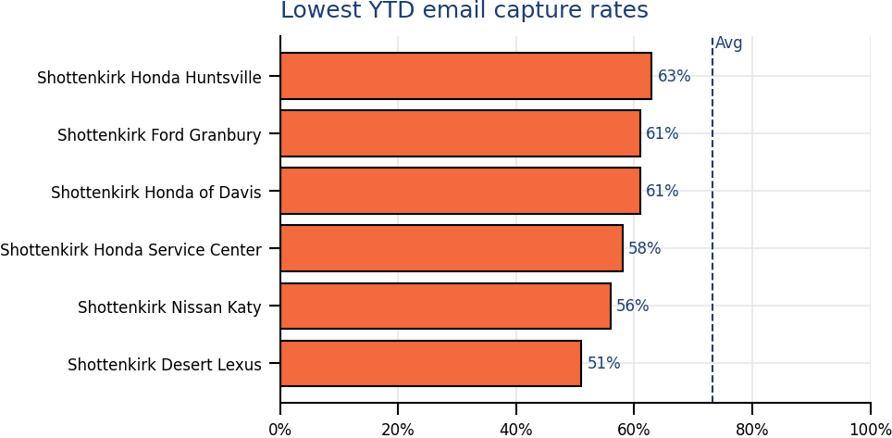
+
Invite Opportunities: Email Capture Gaps
•
Low capture stores highlight where front-end email capture and contact validation need tighter daily management.
What this slide shows
Stores with lower email-capture performance should be reviewed first for write-up process gaps.
Manager focus
Review no-email ROs during the daily lane huddle.
Coach email capture at write-up, before the RO is closed.
Audit exceptions by advisor to identify repeat process misses.
Recommended action
Make email capture a visible daily metric and pair the review with advisor-level coaching on contact validation and opt-out handling.
Cox Automotive
10
Notes:
[Sources]
Data source: Shottenkirk Invite Stats .xlsx
Design reference: Shottenkirk_Fixed_Operations_Workshop 11-3-2025.pptx

Slide 15
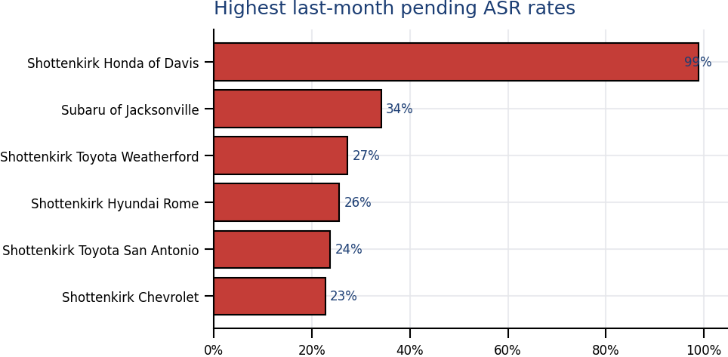
+
Invite Opportunities: Pending ASR Rates
•
Pending ASR discipline needs clear ownership, same-day follow-up, and visible review by store leadership.
What this slide shows
The highest pending ASR rates are the stores where follow-up discipline should be most visible.
Manager focus
Assign ASR ownership before the customer leaves.
Confirm same-day follow-up status by end of day.
Review open declines and pending ASRs together.
• Daily review: pending ASRs, open declines, and no-email ROs should be visible in the same manager rhythm.
• Action threshold: assign ownership before the customer leaves, then confirm follow-up status by end of day.
Highest decline revenue
Declines
Pending ASR
Toyota San Antonio
$49,995
24%
CDJR Canton
$43,764
5%
Honda Cartersville
$42,543
16%
Toyota Weatherford
$38,200
27%
Subaru Jacksonville
$31,477
34%
Cox Automotive
11

Slide 16
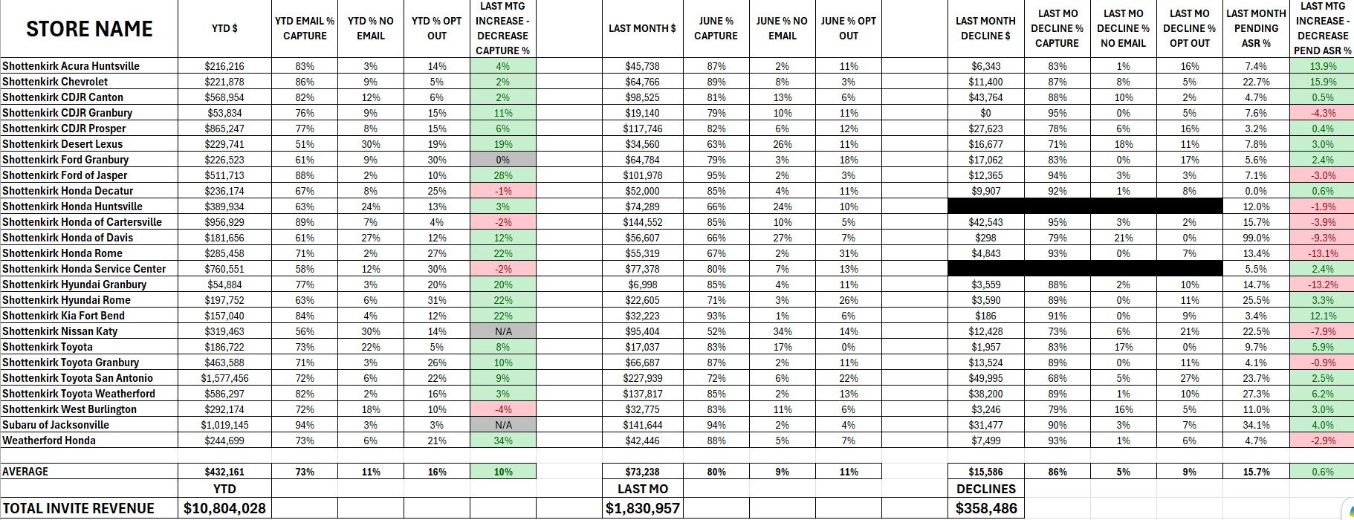

Slide 17
+
30-Day Operating Rhythm
•
A simple cadence to make media and Invite habits visible, coachable, and repeatable.
Daily lane huddle
Review yesterday’s no-media ROs, pending ASRs, and contact capture misses.
Advisor coaching
Use 2 live examples: one strong media quote and one no-media quote that should have had proof.
Technician expectation
MPI + ASR + media must tell a clear story: what is needed, why it matters, and what happens if deferred.
Manager review
Track media %, quote-send rate, closing rate with media, Invite capture, and pending ASR by store.
Weekly recap
Call out one win, one gap, one next action for each store.
Suggested meeting close: each store names one media behavior and one Invite follow-up behavior to improve before the next review.
Cox Automotive
12
Notes:
[Sources]
Data source: Shotenkirk Media Report YTD 6-30-2026.xlsx
Data source: Shottenkirk Invite Stats .xlsx
Design reference: Shottenkirk_Fixed_Operations_Workshop 11-3-2025.pptx

Slide 18
Recap
What is the first thing you will do when you are back at your store?
1
Which store process will you inspect first?
2
Which media behavior needs the most coaching?
3
Which Invite follow-up action will you hold daily?
Cox Automotive
13
Notes:
[Sources]
Data source: Shotenkirk Media Report YTD 6-30-2026.xlsx
Data source: Shottenkirk Invite Stats .xlsx
Design reference: Shottenkirk_Fixed_Operations_Workshop 11-3-2025.pptx

Slide 19
YEAR OVER YEAR REPORT CARDS
SERVICE WORKSHOP
AUGUST 2026 - IRVING TEXAS

Slide 20

YEAR OVER YEAR CUSTOMER PAY
SERVICE WORKSHOP
All Rights Reserved – Shottenkirk Automotive Group - 2026
Notes:
9:45-10:20

Slide 21
YEAR OVER YEAR WARRANTY
SERVICE WORKSHOP
All Rights Reserved – Shottenkirk Automotive Group - 2026
Notes:
9:45-10:20

Slide 22
YEAR OVER YEAR INTERNAL
SERVICE WORKSHOP
All Rights Reserved – Shottenkirk Automotive Group - 2026
Notes:
9:45-10:20

Slide 23

YEAR OVER YEAR CUSTOMER PAY
SERVICE WORKSHOP
All Rights Reserved – Shottenkirk Automotive Group - 2026
Notes:
9:45-10:20

Slide 24
YEAR OVER YEAR WARRANTY
SERVICE WORKSHOP
All Rights Reserved – Shottenkirk Automotive Group - 2026
Notes:
9:45-10:20

Slide 25
YEAR OVER YEAR INTERNAL
SERVICE WORKSHOP
All Rights Reserved – Shottenkirk Automotive Group - 2026
Notes:
9:45-10:20

Slide 26

YEAR OVER YEAR CUSTOMER PAY
SERVICE WORKSHOP
All Rights Reserved – Shottenkirk Automotive Group - 2026
Notes:
9:45-10:20

Slide 27
YEAR OVER YEAR WARRANTY
SERVICE WORKSHOP
All Rights Reserved – Shottenkirk Automotive Group - 2026
Notes:
9:45-10:20

Slide 28
YEAR OVER YEAR INTERNAL
SERVICE WORKSHOP
All Rights Reserved – Shottenkirk Automotive Group - 2026
Notes:
9:45-10:20

Slide 29

YEAR OVER YEAR CUSTOMER PAY
SERVICE WORKSHOP
All Rights Reserved – Shottenkirk Automotive Group - 2026
Notes:
9:45-10:20

Slide 30
YEAR OVER YEAR WARRANTY
SERVICE WORKSHOP
All Rights Reserved – Shottenkirk Automotive Group - 2026
Notes:
9:45-10:20

Slide 31
YEAR OVER YEAR INTERNAL
SERVICE WORKSHOP
All Rights Reserved – Shottenkirk Automotive Group - 2026
Notes:
9:45-10:20

Slide 32

YEAR OVER YEAR CUSTOMER PAY
SERVICE WORKSHOP
All Rights Reserved – Shottenkirk Automotive Group - 2026
Notes:
9:45-10:20

Slide 33
YEAR OVER YEAR WARRANTY
SERVICE WORKSHOP
All Rights Reserved – Shottenkirk Automotive Group - 2026
Notes:
9:45-10:20

Slide 34
YEAR OVER YEAR INTERNAL
SERVICE WORKSHOP
All Rights Reserved – Shottenkirk Automotive Group - 2026
Notes:
9:45-10:20

Slide 35

YEAR OVER YEAR CUSTOMER PAY
SERVICE WORKSHOP
All Rights Reserved – Shottenkirk Automotive Group - 2026
Notes:
9:45-10:20

Slide 36
YEAR OVER YEAR WARRANTY
SERVICE WORKSHOP
All Rights Reserved – Shottenkirk Automotive Group - 2026
Notes:
9:45-10:20

Slide 37
YEAR OVER YEAR INTERNAL
SERVICE WORKSHOP
All Rights Reserved – Shottenkirk Automotive Group - 2026
Notes:
9:45-10:20

Slide 38

YEAR OVER YEAR CUSTOMER PAY
SERVICE WORKSHOP
All Rights Reserved – Shottenkirk Automotive Group - 2026
Notes:
9:45-10:20

Slide 39
YEAR OVER YEAR WARRANTY
SERVICE WORKSHOP
All Rights Reserved – Shottenkirk Automotive Group - 2026
Notes:
9:45-10:20

Slide 40
YEAR OVER YEAR INTERNAL
SERVICE WORKSHOP
All Rights Reserved – Shottenkirk Automotive Group - 2026
Notes:
9:45-10:20

Slide 41

YEAR OVER YEAR CUSTOMER PAY
SERVICE WORKSHOP
All Rights Reserved – Shottenkirk Automotive Group - 2026
Notes:
9:45-10:20

Slide 42
YEAR OVER YEAR WARRANTY
SERVICE WORKSHOP
All Rights Reserved – Shottenkirk Automotive Group - 2026
Notes:
9:45-10:20

Slide 43
YEAR OVER YEAR INTERNAL
SERVICE WORKSHOP
All Rights Reserved – Shottenkirk Automotive Group - 2026
Notes:
9:45-10:20

Slide 44

YEAR OVER YEAR CUSTOMER PAY
SERVICE WORKSHOP
All Rights Reserved – Shottenkirk Automotive Group - 2026
Notes:
9:45-10:20

Slide 45
YEAR OVER YEAR WARRANTY
SERVICE WORKSHOP
All Rights Reserved – Shottenkirk Automotive Group - 2026
Notes:
9:45-10:20

Slide 46
YEAR OVER YEAR INTERNAL
SERVICE WORKSHOP
All Rights Reserved – Shottenkirk Automotive Group - 2026
Notes:
9:45-10:20

Slide 47

YEAR OVER YEAR CUSTOMER PAY
SERVICE WORKSHOP
All Rights Reserved – Shottenkirk Automotive Group - 2026
Notes:
9:45-10:20

Slide 48
YEAR OVER YEAR WARRANTY
SERVICE WORKSHOP
All Rights Reserved – Shottenkirk Automotive Group - 2026
Notes:
9:45-10:20

Slide 49
YEAR OVER YEAR INTERNAL
SERVICE WORKSHOP
All Rights Reserved – Shottenkirk Automotive Group - 2026
Notes:
9:45-10:20

Slide 50

YEAR OVER YEAR CUSTOMER PAY
SERVICE WORKSHOP
All Rights Reserved – Shottenkirk Automotive Group - 2026
Notes:
9:45-10:20

Slide 51
YEAR OVER YEAR WARRANTY
SERVICE WORKSHOP
All Rights Reserved – Shottenkirk Automotive Group - 2026
Notes:
9:45-10:20

Slide 52
YEAR OVER YEAR INTERNAL
SERVICE WORKSHOP
All Rights Reserved – Shottenkirk Automotive Group - 2026
Notes:
9:45-10:20

Slide 53

YEAR OVER YEAR CUSTOMER PAY
SERVICE WORKSHOP
All Rights Reserved – Shottenkirk Automotive Group - 2026
Notes:
9:45-10:20

Slide 54
YEAR OVER YEAR WARRANTY
SERVICE WORKSHOP
All Rights Reserved – Shottenkirk Automotive Group - 2026
Notes:
9:45-10:20

Slide 55
YEAR OVER YEAR INTERNAL
SERVICE WORKSHOP
All Rights Reserved – Shottenkirk Automotive Group - 2026
Notes:
9:45-10:20

Slide 56

YEAR OVER YEAR CUSTOMER PAY
SERVICE WORKSHOP
All Rights Reserved – Shottenkirk Automotive Group - 2026
Notes:
9:45-10:20

Slide 57
YEAR OVER YEAR WARRANTY
SERVICE WORKSHOP
All Rights Reserved – Shottenkirk Automotive Group - 2026
Notes:
9:45-10:20

Slide 58
YEAR OVER YEAR INTERNAL
SERVICE WORKSHOP
All Rights Reserved – Shottenkirk Automotive Group - 2026
Notes:
9:45-10:20

Slide 59

YEAR OVER YEAR CUSTOMER PAY
SERVICE WORKSHOP
All Rights Reserved – Shottenkirk Automotive Group - 2026
Notes:
9:45-10:20

Slide 60
YEAR OVER YEAR WARRANTY
SERVICE WORKSHOP
All Rights Reserved – Shottenkirk Automotive Group - 2026
Notes:
9:45-10:20

Slide 61
YEAR OVER YEAR INTERNAL
SERVICE WORKSHOP
All Rights Reserved – Shottenkirk Automotive Group - 2026
Notes:
9:45-10:20

Slide 62

YEAR OVER YEAR CUSTOMER PAY
SERVICE WORKSHOP
All Rights Reserved – Shottenkirk Automotive Group - 2026
Notes:
9:45-10:20

Slide 63
YEAR OVER YEAR WARRANTY
SERVICE WORKSHOP
All Rights Reserved – Shottenkirk Automotive Group - 2026
Notes:
9:45-10:20

Slide 64
YEAR OVER YEAR INTERNAL
SERVICE WORKSHOP
All Rights Reserved – Shottenkirk Automotive Group - 2026
Notes:
9:45-10:20

Slide 65

YEAR OVER YEAR CUSTOMER PAY
SERVICE WORKSHOP
All Rights Reserved – Shottenkirk Automotive Group - 2026
Notes:
9:45-10:20

Slide 66
YEAR OVER YEAR WARRANTY
SERVICE WORKSHOP
All Rights Reserved – Shottenkirk Automotive Group - 2026
Notes:
9:45-10:20

Slide 67
YEAR OVER YEAR INTERNAL
SERVICE WORKSHOP
All Rights Reserved – Shottenkirk Automotive Group - 2026
Notes:
9:45-10:20

Slide 68

YEAR OVER YEAR CUSTOMER PAY
SERVICE WORKSHOP
All Rights Reserved – Shottenkirk Automotive Group - 2026
Notes:
9:45-10:20

Slide 69
YEAR OVER YEAR WARRANTY
SERVICE WORKSHOP
All Rights Reserved – Shottenkirk Automotive Group - 2026
Notes:
9:45-10:20

Slide 70
YEAR OVER YEAR INTERNAL
SERVICE WORKSHOP
All Rights Reserved – Shottenkirk Automotive Group - 2026
Notes:
9:45-10:20

Slide 71

YEAR OVER YEAR CUSTOMER PAY
SERVICE WORKSHOP
All Rights Reserved – Shottenkirk Automotive Group - 2026
Notes:
9:45-10:20

Slide 72
YEAR OVER YEAR WARRANTY
SERVICE WORKSHOP
All Rights Reserved – Shottenkirk Automotive Group - 2026
Notes:
9:45-10:20

Slide 73
YEAR OVER YEAR INTERNAL
SERVICE WORKSHOP
All Rights Reserved – Shottenkirk Automotive Group - 2026
Notes:
9:45-10:20

Slide 74

YEAR OVER YEAR CUSTOMER PAY
SERVICE WORKSHOP
All Rights Reserved – Shottenkirk Automotive Group - 2026
Notes:
9:45-10:20

Slide 75
YEAR OVER YEAR WARRANTY
SERVICE WORKSHOP
All Rights Reserved – Shottenkirk Automotive Group - 2026
Notes:
9:45-10:20

Slide 76
YEAR OVER YEAR INTERNAL
SERVICE WORKSHOP
All Rights Reserved – Shottenkirk Automotive Group - 2026
Notes:
9:45-10:20

Slide 77

YEAR OVER YEAR CUSTOMER PAY
SERVICE WORKSHOP
All Rights Reserved – Shottenkirk Automotive Group - 2026
Notes:
9:45-10:20

Slide 78
YEAR OVER YEAR WARRANTY
SERVICE WORKSHOP
All Rights Reserved – Shottenkirk Automotive Group - 2026
Notes:
9:45-10:20

Slide 79
YEAR OVER YEAR INTERNAL
SERVICE WORKSHOP
All Rights Reserved – Shottenkirk Automotive Group - 2026
Notes:
9:45-10:20

Slide 80

YEAR OVER YEAR CUSTOMER PAY
SERVICE WORKSHOP
All Rights Reserved – Shottenkirk Automotive Group - 2026
Notes:
9:45-10:20

Slide 81
YEAR OVER YEAR WARRANTY
SERVICE WORKSHOP
All Rights Reserved – Shottenkirk Automotive Group - 2026
Notes:
9:45-10:20

Slide 82
YEAR OVER YEAR INTERNAL
SERVICE WORKSHOP
All Rights Reserved – Shottenkirk Automotive Group - 2026
Notes:
9:45-10:20

Slide 83

YEAR OVER YEAR CUSTOMER PAY
SERVICE WORKSHOP
All Rights Reserved – Shottenkirk Automotive Group - 2026
Notes:
9:45-10:20

Slide 84
YEAR OVER YEAR WARRANTY
SERVICE WORKSHOP
All Rights Reserved – Shottenkirk Automotive Group - 2026
Notes:
9:45-10:20

Slide 85
YEAR OVER YEAR INTERNAL
SERVICE WORKSHOP
All Rights Reserved – Shottenkirk Automotive Group - 2026
Notes:
9:45-10:20

Slide 86

YEAR OVER YEAR CUSTOMER PAY
SERVICE WORKSHOP
All Rights Reserved – Shottenkirk Automotive Group - 2026
Notes:
9:45-10:20

Slide 87
YEAR OVER YEAR WARRANTY
SERVICE WORKSHOP
All Rights Reserved – Shottenkirk Automotive Group - 2026
Notes:
9:45-10:20

Slide 88
YEAR OVER YEAR INTERNAL
SERVICE WORKSHOP
All Rights Reserved – Shottenkirk Automotive Group - 2026
Notes:
9:45-10:20

Slide 89

YEAR OVER YEAR CUSTOMER PAY
SERVICE WORKSHOP
All Rights Reserved – Shottenkirk Automotive Group - 2026
Notes:
9:45-10:20

Slide 90
YEAR OVER YEAR WARRANTY
SERVICE WORKSHOP
All Rights Reserved – Shottenkirk Automotive Group - 2026
Notes:
9:45-10:20

Slide 91
YEAR OVER YEAR INTERNAL
SERVICE WORKSHOP
All Rights Reserved – Shottenkirk Automotive Group - 2026
Notes:
9:45-10:20

Slide 92

YEAR OVER YEAR CUSTOMER PAY
SERVICE WORKSHOP
All Rights Reserved – Shottenkirk Automotive Group - 2026
Notes:
9:45-10:20

Slide 93
YEAR OVER YEAR WARRANTY
SERVICE WORKSHOP
All Rights Reserved – Shottenkirk Automotive Group - 2026
Notes:
9:45-10:20

Slide 94
YEAR OVER YEAR INTERNAL
SERVICE WORKSHOP
All Rights Reserved – Shottenkirk Automotive Group - 2026
Notes:
9:45-10:20

Slide 95

YEAR OVER YEAR CUSTOMER PAY
SERVICE WORKSHOP
All Rights Reserved – Shottenkirk Automotive Group - 2026
Notes:
9:45-10:20

Slide 96
YEAR OVER YEAR WARRANTY
SERVICE WORKSHOP
All Rights Reserved – Shottenkirk Automotive Group - 2026
Notes:
9:45-10:20

Slide 97
YEAR OVER YEAR INTERNAL
SERVICE WORKSHOP
All Rights Reserved – Shottenkirk Automotive Group - 2026
Notes:
9:45-10:20

Slide 98

YEAR OVER YEAR CUSTOMER PAY
SERVICE WORKSHOP
All Rights Reserved – Shottenkirk Automotive Group - 2026
Notes:
9:45-10:20

Slide 99
YEAR OVER YEAR WARRANTY
SERVICE WORKSHOP
All Rights Reserved – Shottenkirk Automotive Group - 2026
Notes:
9:45-10:20

Slide 100
YEAR OVER YEAR INTERNAL
SERVICE WORKSHOP
All Rights Reserved – Shottenkirk Automotive Group - 2026
Notes:
9:45-10:20

Slide 101

YEAR OVER YEAR CUSTOMER PAY
SERVICE WORKSHOP
All Rights Reserved – Shottenkirk Automotive Group - 2026
Notes:
9:45-10:20

Slide 102
YEAR OVER YEAR WARRANTY
SERVICE WORKSHOP
All Rights Reserved – Shottenkirk Automotive Group - 2026
Notes:
9:45-10:20

Slide 103
YEAR OVER YEAR INTERNAL
SERVICE WORKSHOP
All Rights Reserved – Shottenkirk Automotive Group - 2026
Notes:
9:45-10:20

Slide 104
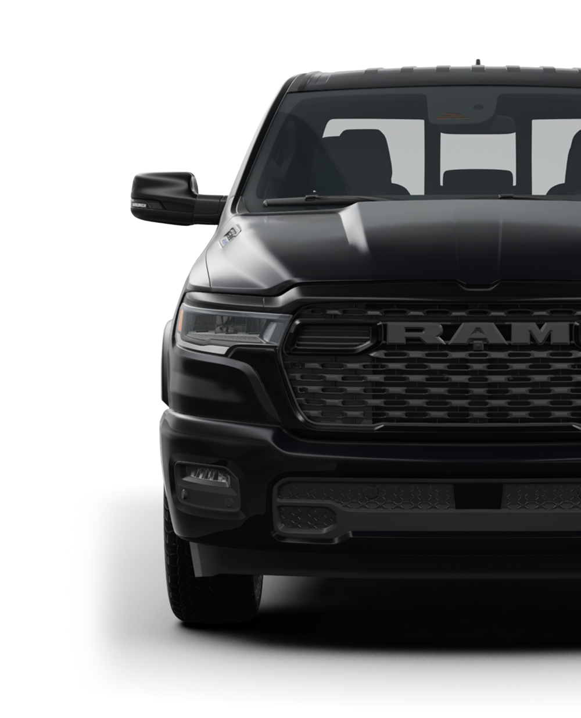
LUNCH
SERVICE WORKSHOP
AUGUST 2026 - IRVING TEXAS

Slide 105

JONATHON NELSON
SERVICE WORKSHOP
AUGUST 2026 - IRVING TEXAS

Slide 106
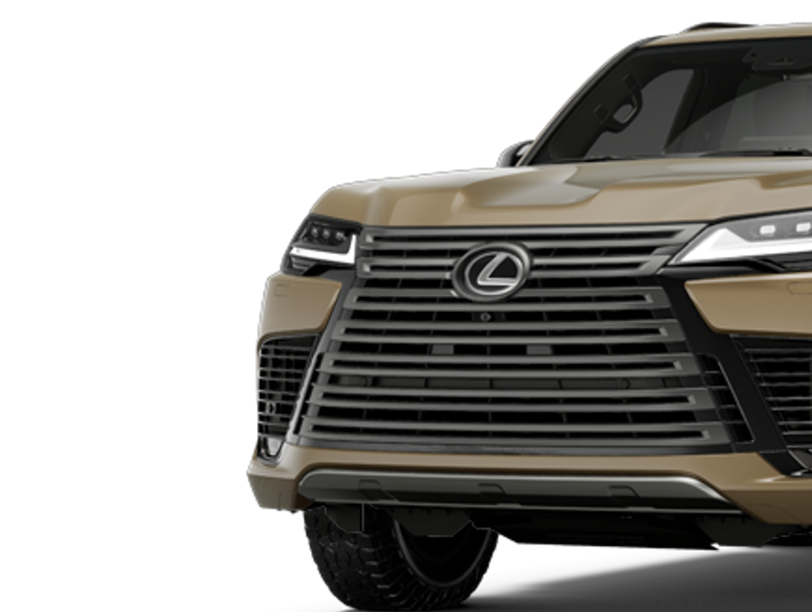
SANTOS RODRIGUEZ
SERVICE WORKSHOP
AUGUST 2026 - IRVING TEXAS

Slide 107
TECH
EFFICIENCY
SERVICE WORKSHOP
AUGUST 2026 - IRVING TEXAS

Slide 108
TECH EFFICIENCY
SERVICE WORKSHOP
All Rights Reserved – Shottenkirk Automotive Group - 2026
Notes:
9:45-10:20

Slide 109
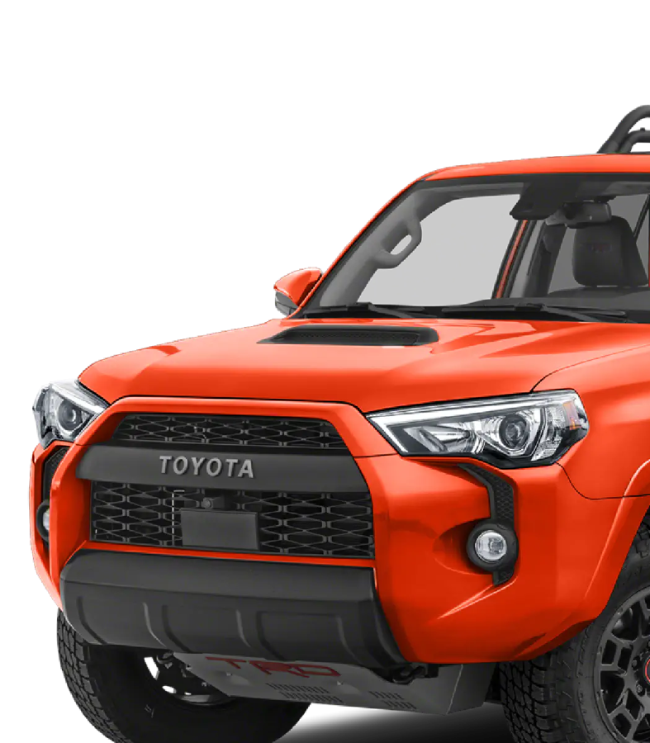
PETE GASCON
SERVICE WORKSHOP
AUGUST 2026 - IRVING TEXAS

Slide 110

SERVICE WORKSHOP
AUGUST 2026 - IRVING TEXAS

Slide 111

SERVICE WORKSHOP
AUGUST 2026 - IRVING TEXAS

Slide 112

6:30

Slide 113

SERVICE WORKSHOP
AUGUST 2026 - IRVING TEXAS

Slide 114

COMPOUND EFFECT
BIG
MO
SERVICE WORKSHOP
All Rights Reserved – Shottenkirk Automotive Group - 2026
Notes:
9:45-10:20

Slide 115
CUSTOMER
RETENTION
SERVICE WORKSHOP
AUGIST 2026 - IRVING TEXAS

Slide 116

CUSTOMER RETENTION
RO # | Customer First Name | Customer Last Name | Service Advisor | TrelaRating | Comment | Date/Time
331984 | DEBBIE | TRAWICK | Ginger Chapman | 100 | N/a | 2026-07-29 08:07:24
332021 | GAYLE | HICKMAN. | Kevin Etters | 100 | No stopwatch; about 50 minutes | 2026-07-28 19:33:38
332022 | CHERYL | DAVIS | Ginger Chapman | 100 | Did not wait | 2026-07-28 18:54:37
332034 | CAROLYN | CRAWFORD | Kevin Etters | 100 | Sorry | 2026-07-28 18:52:36
332060 | DALLAS | DURHAM | Ginger Chapman | 100 | No - 90 min | 2026-07-28 18:21:15
332035 | LYNN | HORTON | Ginger Chapman | 100 | No stopwatch repair time was fine | 2026-07-28 18:04:29
331957 | NANCY | GODWIN | Jordan Waters | 100 | No stopwatch but Jordan kept me informed about time. She was very good. | 2026-07-28 14:20:29
331522 | LARRY | PARRIS | Kevin Etters | 100 | Did not wait | 2026-07-28 09:57:39
331839 | RUTH | MCRAE | Ginger Chapman | 100 | No stopwatch, 120 minutes, but it was a very busy day | 2026-07-28 08:34:32
331959 | WILLIAM | LLOYD | Richie Goetz | 100 | No, waited 2 hours | 2026-07-28 08:27:26
331986 | SARAH | BLACK | Richie Goetz | 40 | No - waited 3hrs | 2026-07-27 20:27:49
331990 | JONATHAN | KEYS | Richie Goetz | 100 | Did not wait | 2026-07-27 19:37:04
331824 | JOHN | GREENE | Kevin Etters | 60 | I dropped off | 2026-07-27 19:19:14
332013 | TIMOTHY | COLEMAN | Kevin Etters | 20 | 110 minutes | 2026-07-27 19:19:08
331939 | THOMAS | GEARHARD | Kevin Etters | 80 | 1 hour | 2026-07-27 19:03:01
331943 | PATRICIA | SPENCER | Kevin Etters | 100 | I dropped it off | 2026-07-27 18:05:21
331956 | KATHY | WEAVER | Ginger Chapman | 100 | 1 1/2 hour | 2026-07-27 15:33:12
331869 | EMORY | WEAVER | Ginger Chapman | 40 | Around 120 | 2026-07-27 09:08:31
331762 | VICKI | BUDA | Richie Goetz | 100 | No ? | 2026-07-26 12:42:07
331909 | ALICIA | STEVENSON | Richie Goetz | 100 | 65 | 2026-07-25 23:23:14
SERVICE WORKSHOP
All Rights Reserved – Shottenkirk Automotive Group - 2026
Notes:
4:15-5:00

Slide 117
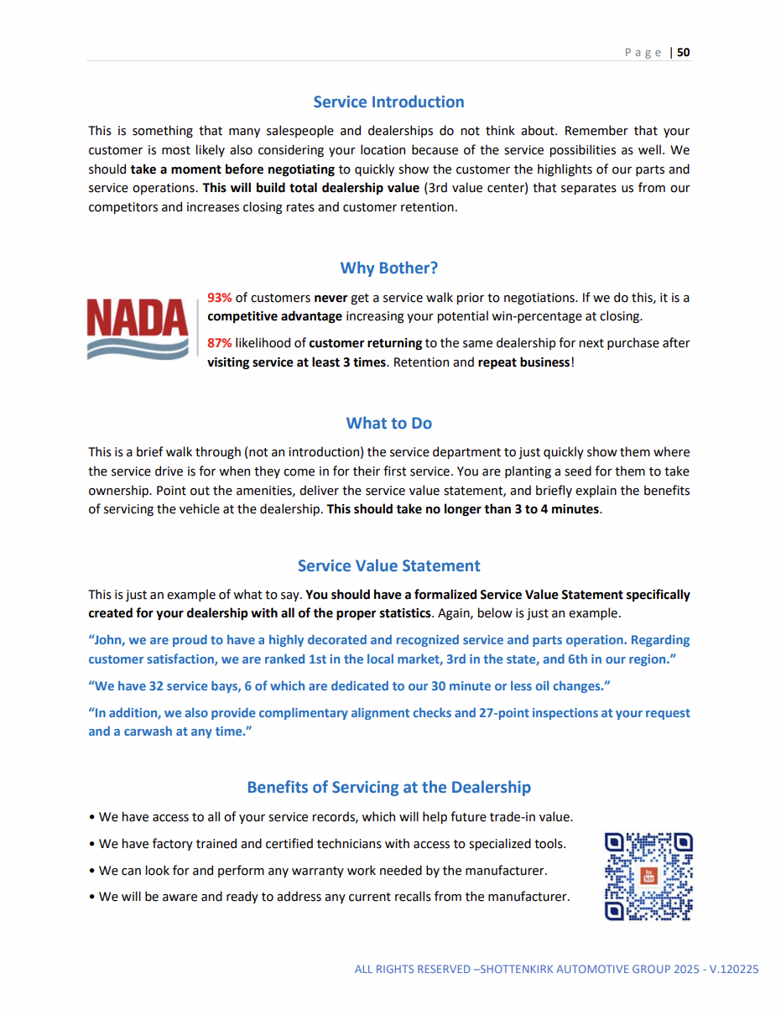
CUSTOMER RETENTION
93%
87%
SERVICE WORKSHOP
All Rights Reserved – Shottenkirk Automotive Group - 2026
Notes:
4:15-5:00

Slide 118
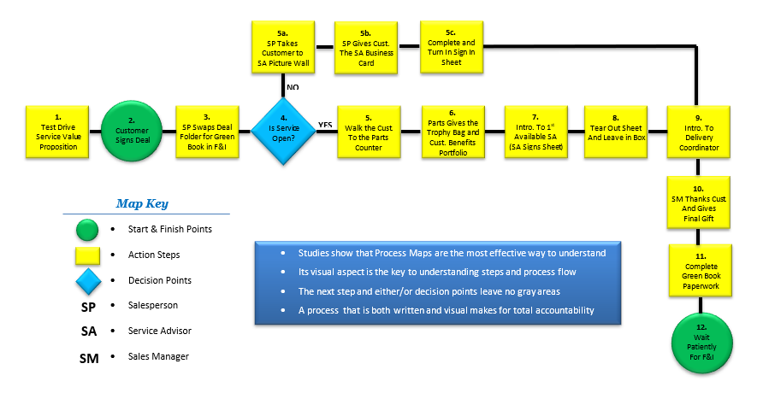
CUSTOMER RETENTION
SERVICE WORKSHOP
All Rights Reserved – Shottenkirk Automotive Group - 2026
Notes:
4:15-5:00

Slide 119
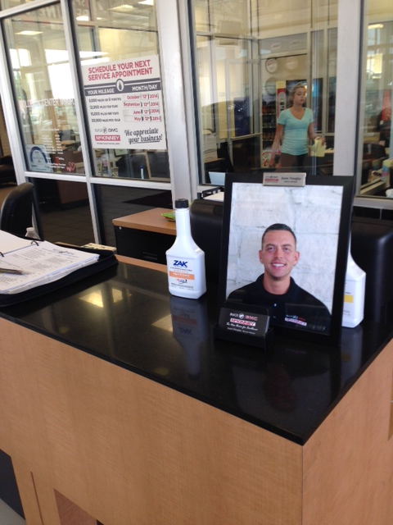
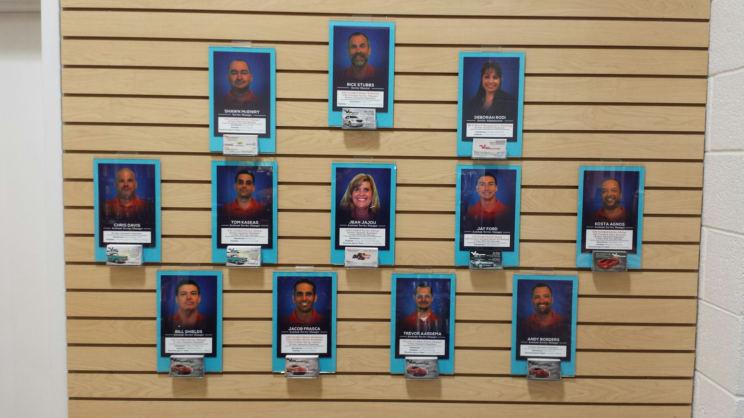
CUSTOMER RETENTION
SERVICE WORKSHOP
All Rights Reserved – Shottenkirk Automotive Group - 2026
Notes:
4:15-5:00

Slide 120
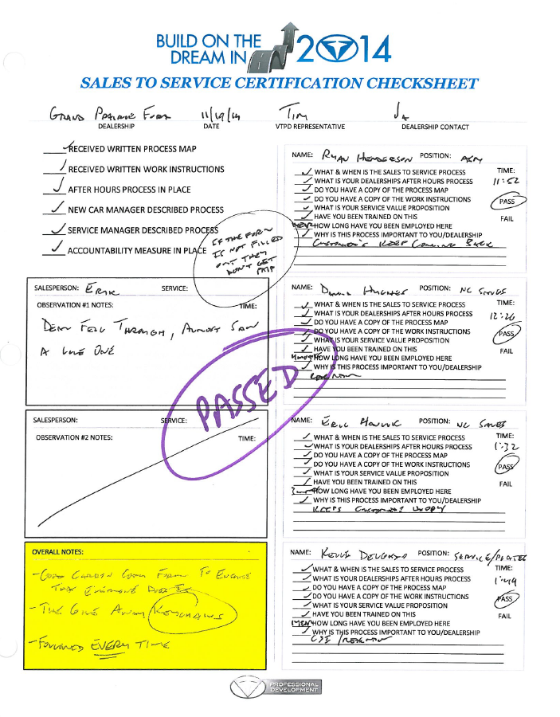
CUSTOMER RETENTION
SERVICE WORKSHOP
All Rights Reserved – Shottenkirk Automotive Group - 2026
Notes:
4:15-5:00

Slide 121
TIM TIPTON
SERVICE WORKSHOP
AUGUST 2026 - IRVING TEXAS

Slide 122
PERFECT MEETING
PREPARATION - HAVE A PURPOSE AND AGENDA
ENGAGEMENT - DON’T BE BORING AND ENCOURAGE INTERACTION
RECOGNITION - PEER RECOGNITION IS CONTAGIOUS
FUN - MIX IT UP AND HAVE SOME COMPETITION
ENCOURAGEMENT - MOTIVATION BEATS DECAPITATION
CREATIVITY - THINK OUTSIDE THE BOX AND INVOLVE OTHERS
TIMELINESS - START/END ON TIME AND GET TO THE POINT
SERVICE WORKSHOP
All Rights Reserved – Shottenkirk Automotive Group - 2026
Notes:
9:45-10:20

Slide 123

PERFECT MEETING
UTILIZE THE ALPHA
CONTROL THE HIJACKER
SQUASH BAD ATTITUDES
CREATE SAFE ENVIRONMENT
SERVICE WORKSHOP
All Rights Reserved – Shottenkirk Automotive Group - 2026
Notes:
9:45-10:20

Slide 124

SERVICE WORKSHOP
TOP 2
TAKEAWAYS
SERVICE WORKSHOP
All Rights Reserved – Shottenkirk Automotive Group - 2025
Notes:
4:15-5:00

