Slide 1

SALES MANAGER 101
AUGUST - 2024
IRVING TEXAS
All Rights Reserved – Shottenkirk Automotive Group - 2024

Slide 2

TIM TIPTON
“You do not rise to the level of your goals. You fall to the level of your systems.”
- James Clear
Author of Atomic Habits
All Rights Reserved – Shottenkirk Automotive Group - 2024

Slide 3
MATT HOWE
“Hire for passion and intensity; there is training for everything else.”
- Nolan Bushnell
Business Leader
All Rights Reserved – Shottenkirk Automotive Group - 2024

Slide 4
TRACY RODENHAVER
“Success is never owned, it is rented. And the rent is due every day.”
- Rory Vaden
Business Leader
All Rights Reserved – Shottenkirk Automotive Group - 2024

Slide 5
MIKE LUCIA
“The harder you work.
The luckier you get.”
- Joe Ricketts
Founder of TD Ameritrade
All Rights Reserved – Shottenkirk Automotive Group - 2024

Slide 6


INTRODUCTION
PARTNER INTODUCTIONS
NAME – DEALERSHIP – TITLE
HOW LONG IN THE BUSINESS
PRIOR OCCUPATION
FAVORITE MOVIE
QUARTERLY IMPROVEMENT WORKSHOP
All Rights Reserved – Shottenkirk Automotive Group - 2024
Notes:
9:30-9:35

Slide 7

SALES MANAGER 101
“On good teams, coaches hold players accountable. On great teams, players hold players accountable.
-Caitlin Clark
QUARTERLY IMPROVEMENT WORKSHOP
All Rights Reserved – Shottenkirk Automotive Group - 2024
Notes:
9:30-9:35

Slide 8
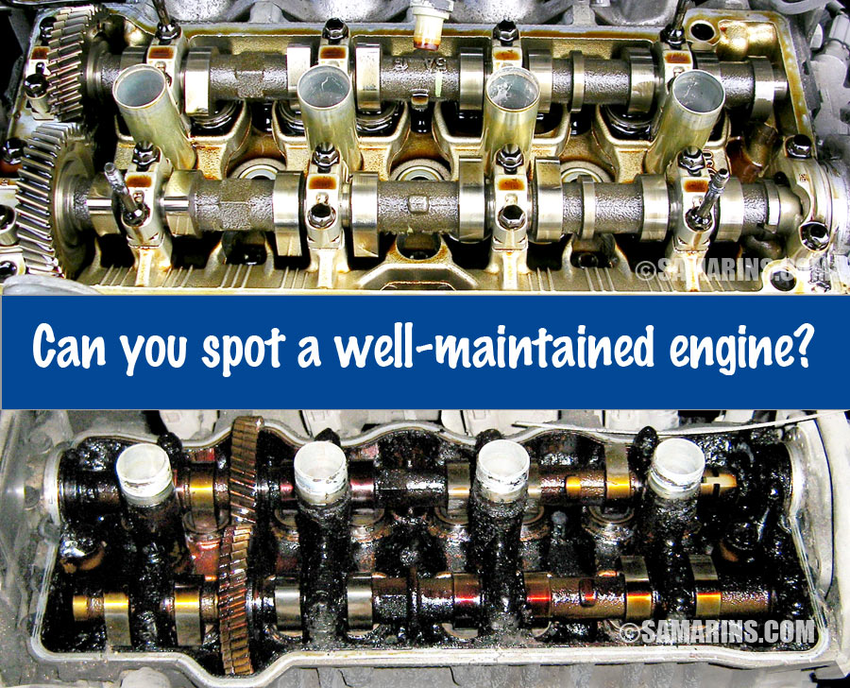
SALES MANAGERS
QUARTERLY IMPROVEMENT WORKSHOP
All Rights Reserved – Shottenkirk Automotive Group - 2024
Notes:
9:30-9:35

Slide 9

SALES MANAGERS
QUARTERLY IMPROVEMENT WORKSHOP
All Rights Reserved – Shottenkirk Automotive Group - 2024
Notes:
9:30-9:35

Slide 10
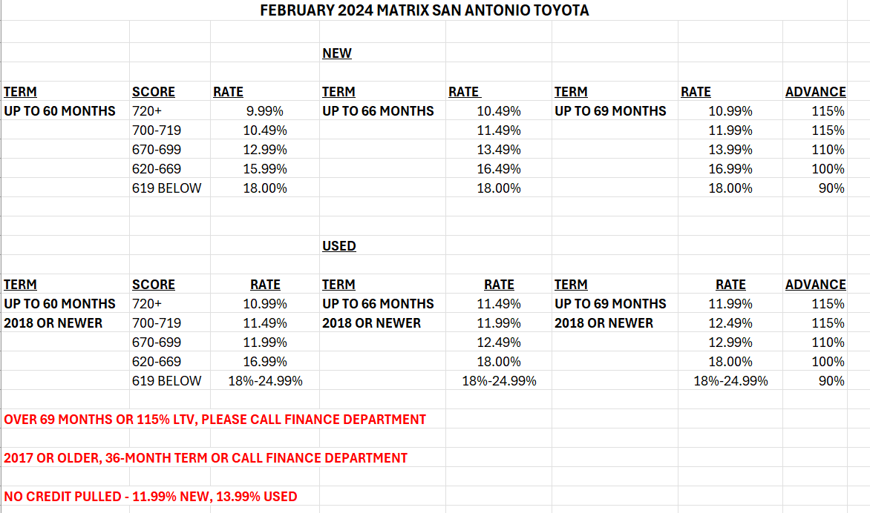
DESKING RATE MATRIX
QUARTERLY IMPROVEMENT WORKSHOP
All Rights Reserved – Shottenkirk Automotive Group - 2024
Notes:
9:30-9:35

Slide 11

INTRODUCTION
QUARTERLY IMPROVEMENT WORKSHOP
All Rights Reserved – Shottenkirk Automotive Group - 2024
Notes:
9:30-9:35

Slide 12
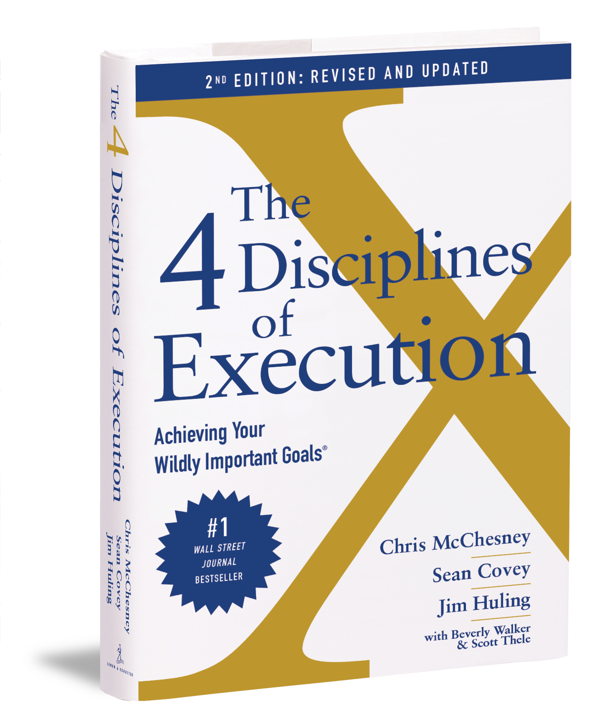
INTRODUCTION
FOCUS ON THE WILDLY IMPORTANT
ACT ON THE LEAD MEASURES
KEEPING A COMPELLING SCOREBOARD
CREATE A CADENCE OF ACCOUNTABILITY
QUARTERLY IMPROVEMENT WORKSHOP
All Rights Reserved – Shottenkirk Automotive Group - 2024
Notes:
9:30-9:35

Slide 13

SALES MANAGER 101
“Be brave enough to suck at something new.”
- Jon Acuff
QUARTERLY IMPROVEMENT WORKSHOP
All Rights Reserved – Shottenkirk Automotive Group - 2024
Notes:
9:30-9:35

Slide 14
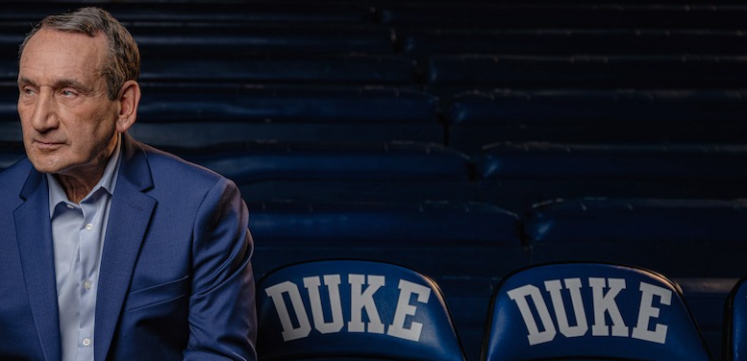
TRAIN THE TRAINER
“It’s not what you know, it’s what you are able to verbalize and teach…
I told them is not a legitimate excuse. It’s on you to get the message across.
“Tell me and I will forget.
Teach me and I may remember.
Involve me and I learn.”
- Coach K
- Benjamin Franklin
QUARTERLY IMPROVEMENT WORKSHOP
All Rights Reserved – Shottenkirk Automotive Group - 2024
Notes:
9:30-9:35

Slide 15

TOP TWO TAKE-AWAYS
“Just live in your three-foot world.”
-Mark Owen
SHOTTENKIRK LEADERSHIP ACADEMY
All Rights Reserved – Shottenkirk Automotive Group - 2022
Notes:
4:20-5:00
What are 2 things in your three-foot world that you want to go back and affect?

Slide 16

FAVORITE BUMPS?
SHOTTENKIRK LEADERSHIP ACADEMY
All Rights Reserved – Shottenkirk Automotive Group - 2022

